Slide 1
Introduction

Slide 2
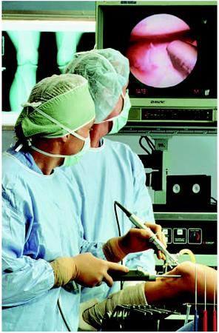
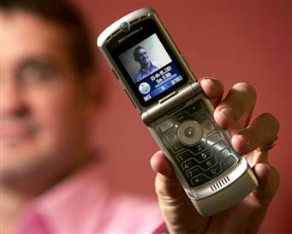
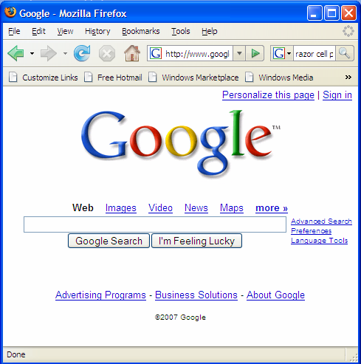
Background
Microprocessors have revolutionized our world
Cell phones, Internet, rapid advances in medicine, etc.
The semiconductor industry has grown from $21 billion in 1985 to $300 billion in 2011

Slide 3
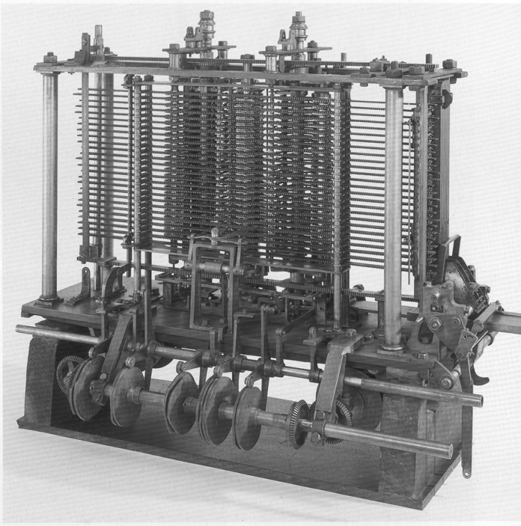
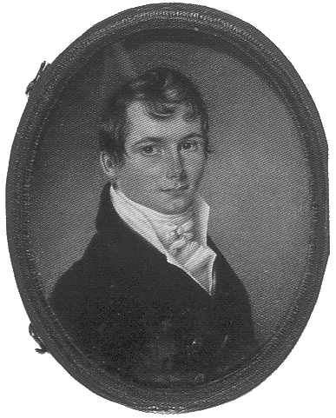
The Analytical Engine
Designed by Charles Babbage from 1834 – 1871
Considered to be the first digital computer
Built from mechanical gears, where each gear represented a discrete value (0-9)
Babbage died before it was finished

Slide 4
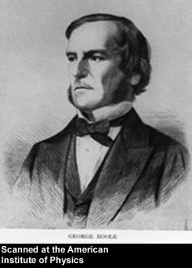
George Boole, 1815-1864
Born to working class parents
Taught himself mathematics and joined the faculty of Queen’s College in Ireland.
Wrote An Investigation of the Laws of Thought (1854)
Introduced binary variables
Introduced the three fundamental logic operations: AND, OR, and NOT.

Slide 5
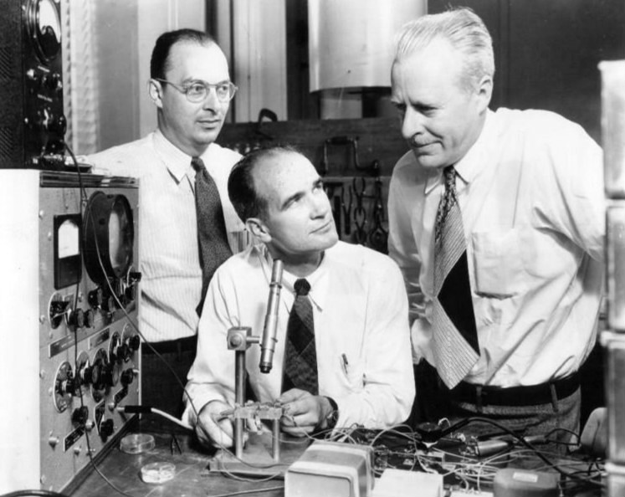
John Bardeen, William Shockley and Walter Brattain
Invented in 1947 the first transistor
Jointly awarded the 1956 Nobel Prize in Physics "for their researches on semiconductors and their discovery of the transistor effect."
John Bardeen, William Shockley and Walter Brattain at Bell Labs, 1948.

Slide 6
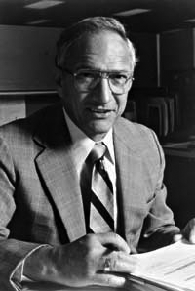
Robert Noyce, 1927-1990
Nicknamed “Mayor of Silicon Valley”
Cofounded Fairchild Semiconductor in 1957
Cofounded Intel in 1968
Co-invented the integrated circuit

Slide 7
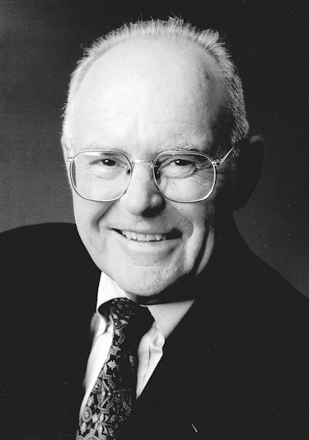
Gordon Moore, 1929-
Cofounded Intel in 1968 with Robert Noyce.
Moore’s Law: number of transistors on a computer chip doubles every year (observed in 1965)
Since 1975, transistor counts have doubled every two years.

Slide 8
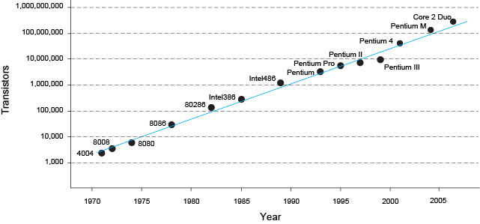
Moore’s Law
“If the automobile had followed the same development cycle as the computer, a Rolls-Royce would today cost $100, get one million miles to the gallon, and explode once a year . . .”
– Robert Cringley

Slide 9
The Three -Y’s
Hierarchy
A system divided into modules and submodules
Modularity
Having well-defined functions and interfaces
Regularity
Encouraging uniformity, so modules can be easily reused

Slide 10
Electronic Design Automation (EDA)
Results
(design productivity)
What’s next?
Synthesis – Cadence, Synopsys
Schematic entry – Daisy, Mentor, Valid
Transistor entry – Calma, Computervision, Magic
Effort
(EDA tool effort)

Slide 11
Simple Processor

Slide 12
Course Objective
Understand what’s under the hood of a computer
Learn the principles of digital design
Learn FPGA based design tools
Learn to systematically debug increasingly complex designs
Design and build a microprocessor

